Slide 1
Digital Data Transmission

Slide 2
Digital Transmission
A computer network is designed to send information from one point to another.
This information needs to be converted to either a digital signal (digital transmission) or an analog signal (analog transmission).
In Digital transmission:(1) methods which convert digital data to digital signals (digital-to-digital conversion) and(2) methods which convert analog signals to digital signals (analog-to-digital conversion)

Slide 3
Both analog and digital information can be encoded as either analog or digital signals.
The particular encoding that is chosen depends on the specific requirements to be met and the media and communications facilities available.

Slide 4

Digital data, digital signals: The simplest form of digital encoding of digital data is to assign one voltage level to binary one and another to binary zero. More complex encoding schemes are used to improve performance, by altering the spectrum of the signal and providing synchronization capability.
Digital data, analog signal: A modem converts digital data to an analog signal so that it can be transmitted over an analog line. The basic techniques are amplitude shift keying (ASK), frequency shift keying (FSK), and phase shift keying (PSK). All involve altering one or more characteristics of a carrier frequency to represent binary data.

Slide 5
Analog data, digital signals: Analog data, such as voice and video, are often digitized to be able to use digital transmission facilities. The simplest technique is pulse code modulation (PCM), which involves sampling the analog data periodically and quantizing the samples.
Analog data, analog signals: Analog data are modulated by a carrier frequency to produce an analog signal in a different frequency band, which can be utilized on an analog transmission system. The basic techniques are amplitude modulation (AM), frequency modulation (FM), and phase modulation (PM).

Slide 6








For digital signaling, a data source g(t), which may be either digital or analog, is encoded into a digital signal x(t).The actual form of x(t) depends on the encoding technique and is chosen to optimize use of the transmission medium. For example, the encoding may be chosen to conserve bandwidth or to minimize errors.
The basis for analog signaling is a continuous constant-frequency signal known as the carrier signal. The frequency of the carrier signal is chosen to be compatible with the transmission medium being used. Data may be transmitted using a carrier signal by modulation. Modulation is the process of encoding source data onto a carrier signal with frequency. All modulation techniques involve operation on one or more of the three fundamental frequency domain parameters: amplitude, frequency, and phase.

Slide 8
The input signal m(t) may be analog or digital and is called the modulating signal or baseband signal. The result of modulating the carrier signal is called the modulated signal s(t).
Figure indicates, s(t) is a bandlimited (bandpass) signal. The location of the bandwidth on the spectrum is related to and is often centered on. Again, the actual form of the encoding is chosen to optimize some characteristic of the transmission.

Slide 9
DIGITAL-TO-DIGITAL CONVERSION
How to convert digital data into digital signals.
It can be done using line coding, block coding and scrambling. For all communications, line coding is necessary whereas block coding and scrambling are optional.

Slide 10
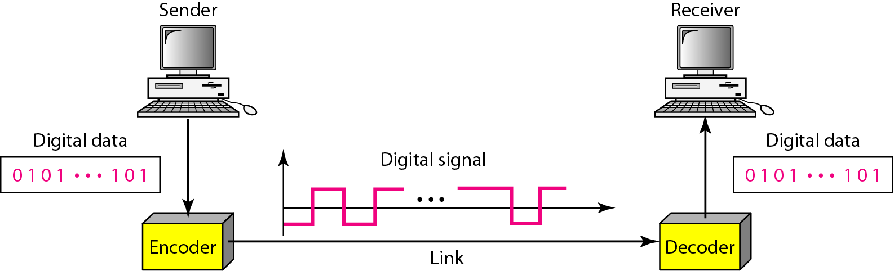
Line Coding
The process for converting digital data into digital signal is said to be Line Coding. Digital data is found in binary format. It is represented (stored) internally as series of 1s and 0s.

Slide 11


SIGNAL ELEMENT VERSUS DATA ELEMENT
A data element is the smallest entity that can represent a piece of
information: this is the bit.
In digital data communications, a signal element carries data elements.
A signal element is the shortest unit (time wise) of a digital signal.
In other words, data elements are what we need to send, signal elements are what we can send. Data elements are being carried and signal elements are the carriers.
The ratio ‘r’ is the number of data elements carried by a signal element.

Slide 12
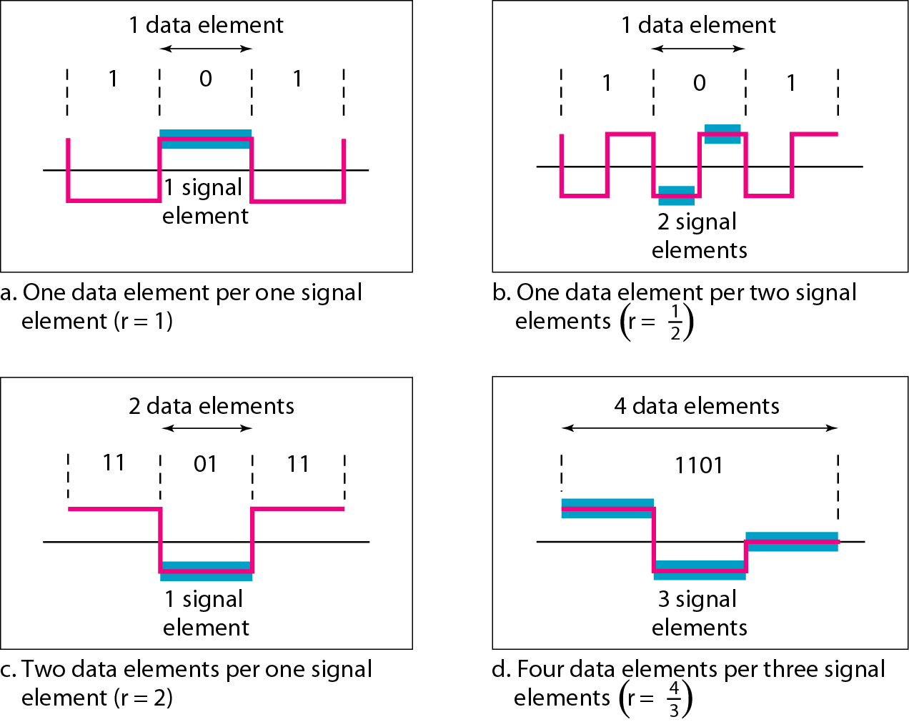
Signal element versus data element

Slide 13
Fig(a) -one data element is carried by one signal element (r = 1).
Fig (b) - two signal elements (two transitions) to carry each data element (r = 1/2 ).
Fig (c) - a signal element carries two data elements (r = 2).
Fig (d) - a group of 4 bits is being carried by a group of three signal elements (r = 4/3)

Slide 14
Common characteristics
Mapping Data symbols onto Signal levels
A data symbol (or element) can consist of a number of data bits:
1 , 0 or
11, 10, 01, ……
A data symbol can be coded into a single signal element or multiple signal elements
1 -> +V, 0 -> -V
1 -> +V and -V, 0 -> -V and +V

Slide 15
Relationship between data rate and signal rate
The data rate defines the number of bits sent per sec - bps. It is often referred to the bit rate.
The signal rate is the number of signal elements sent in a second and is measured in bauds. It is also referred to as the modulation rate.
Goal is to increase the data rate whilst reducing the baud rate.

Slide 16
Data rate and Baud rate
The baud or signal rate can be expressed as:
S = c x N x 1/r bauds
where N is data rate
c is the case factor (worst, best & avg.)
r is the ratio between data element & signal element

Slide 17
Line Encoding
Considerations for choosing a good signal element referred to as line encoding
Baseline wandering
DC components
Self synchronization
Error detection
Noise and interference
Complexity

Slide 18


Baseline wandering – a receiver will evaluate the average power of the received signal (called the baseline) and use that to determine the value of the incoming data elements. If the incoming signal does not vary over a long period of time (A long string of 0s or 1s), the baseline will drift (Baseline wandering) and thus cause errors in detection of incoming data elements.
A good line encoding scheme will prevent long runs of fixed amplitude.

Slide 19
DC components - when the voltage level remains constant for long periods of time, there is an increase in the low frequencies of the signal. Most channels are bandpass and may not support the low frequencies.
This will require the removal of the dc component of a transmitted signal.

Slide 20
Self synchronization - the clocks at the sender and the receiver must have the same bit interval.
If the receiver clock is faster or slower it will misinterpret the incoming bit stream.

Slide 21
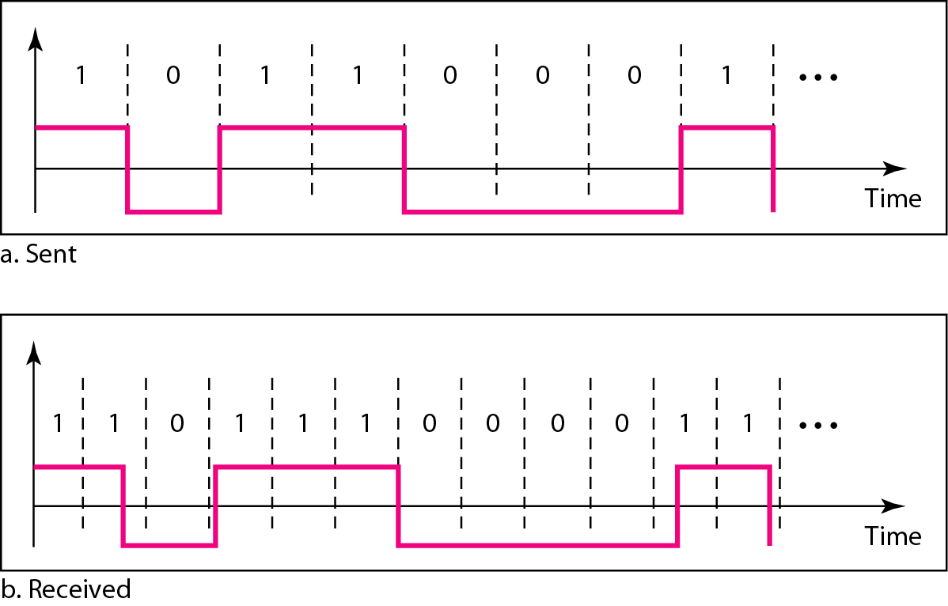
Effect of lack of synchronization

Slide 22
Error detection - errors occur during transmission due to line impairments.
Some codes are constructed such that when an error occurs it can be detected. For example: a particular signal transition is not part of the code. When it occurs, the receiver will know that a symbol error has occurred.

Slide 23
Noise and interference - there are line encoding techniques that make the transmitted signal “immune” to noise and interference.
This means that the signal cannot be corrupted, it is stronger than error detection.
Complexity - the more robust and resilient the code, the more complex it is to implement and the price is often paid in baud rate or required bandwidth.

Slide 24
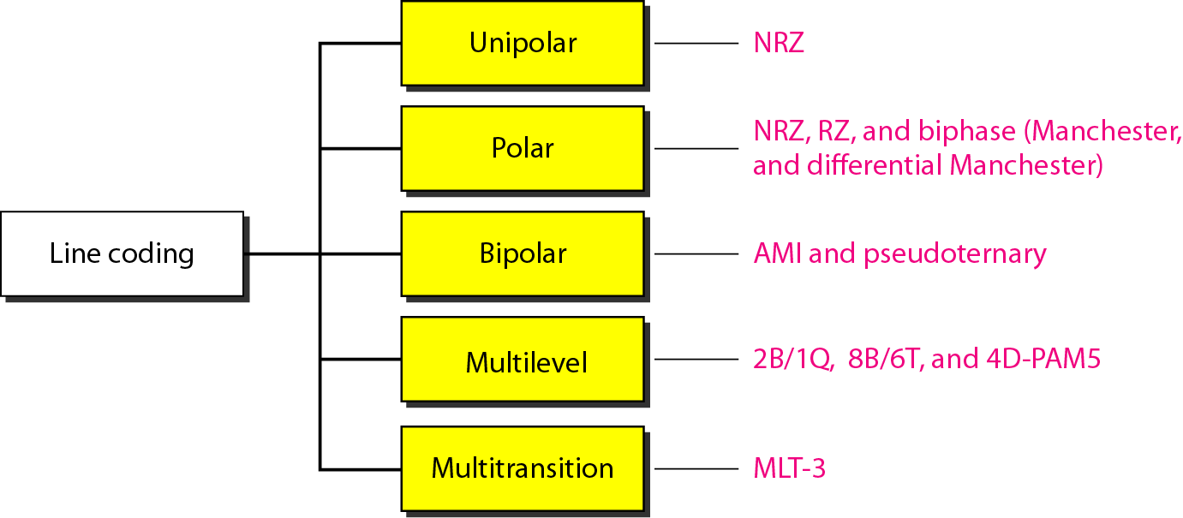
Line coding schemes

Slide 25
Unipolar
All signal levels are on one side of the time axis - either above or below
NRZ - Non Return to Zero scheme is an example of this code. Traditionally, a unipolar scheme was designed as a non-return-to-zero (NRZ) scheme in which the positive voltage defines bit 1 and the zero voltage defines bit 0.
The signal level does not return to zero during a symbol transmission i.e., the signal does not return to zero at the middle of the bit.
Scheme is prone to baseline wandering and DC components. It has no synchronization or any error detection. It is simple but costly in power consumption.

Slide 26
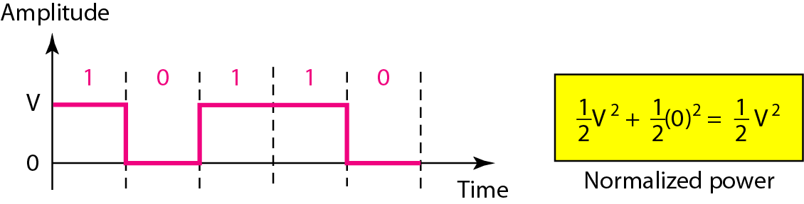
Unipolar NRZ scheme

Slide 27
Polar - NRZ
The voltages are on both sides of the time axis.
Polar NRZ scheme can be implemented with two voltages. E.g. +V for 1 and -V for 0.
There are two versions:
NRZ- Level (NRZ-L) - positive voltage for one symbol and negative for the other
NRZ - Inversion (NRZ-I) - the change or lack of change in polarity determines the value of a symbol. If there is no change, the bit is 0, if there is a change, the bit is 1.

Slide 28
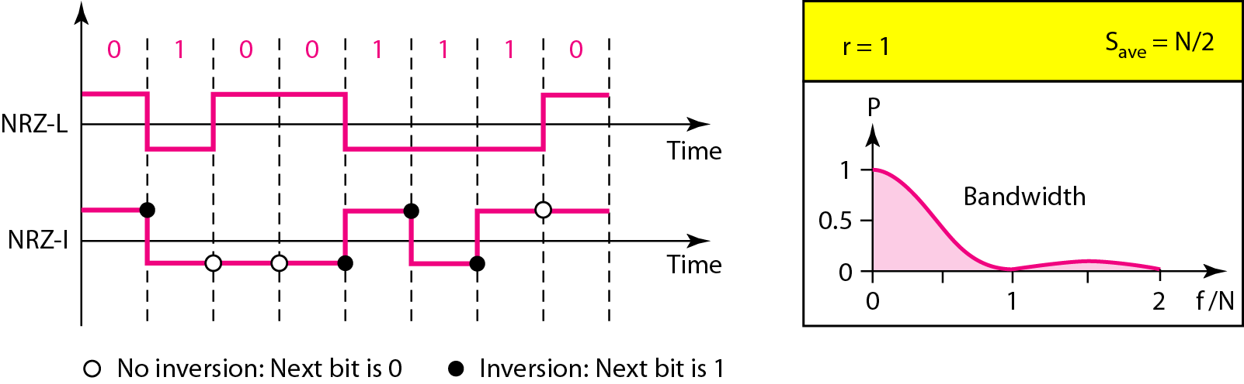
Polar NRZ-L and NRZ-I schemes

Slide 29
In NRZ-L the level of the voltage determines the value of the bit. In NRZ-I the inversion or the lack of inversion determines the value of the bit.
NRZ-L and NRZ-I both have an average signal rate of N/2 Bd.
NRZ-L and NRZ-I both have a DC component problem and baseline wandering, it is worse for NRZ-L. Both have no self synchronization &no error detection. Both are relatively simple to implement.

Slide 30



Polar - RZ
The Return to Zero (RZ) scheme uses three voltage values. +, 0, -.
Each symbol has a transition in the middle. Either from high to zero or from low to zero.
This scheme has more signal transitions (two per symbol) and therefore requires a wider bandwidth.
No DC components or baseline wandering.
Self synchronization - transition indicates symbol value.
More complex as it uses three voltage level. It has no error detection capability.

Slide 31
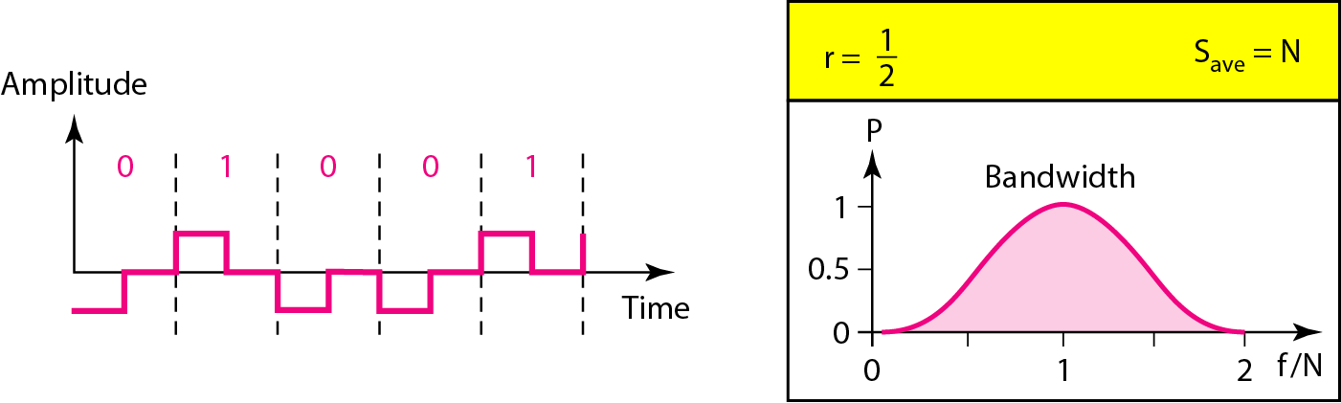
Polar RZ scheme

Slide 32
Polar - Biphase: Manchester and Differential Manchester
Manchester coding consists of combining the NRZ-L and RZ schemes.
Every symbol has a level transition in the middle: from high to low or low to high. Uses only two voltage levels.
Differential Manchester coding consists of combining the NRZ-I and RZ schemes.
Every symbol has a level transition in the middle. But the level at the beginning of the symbol is determined by the symbol value. One symbol causes a level change the other does not.

Slide 33
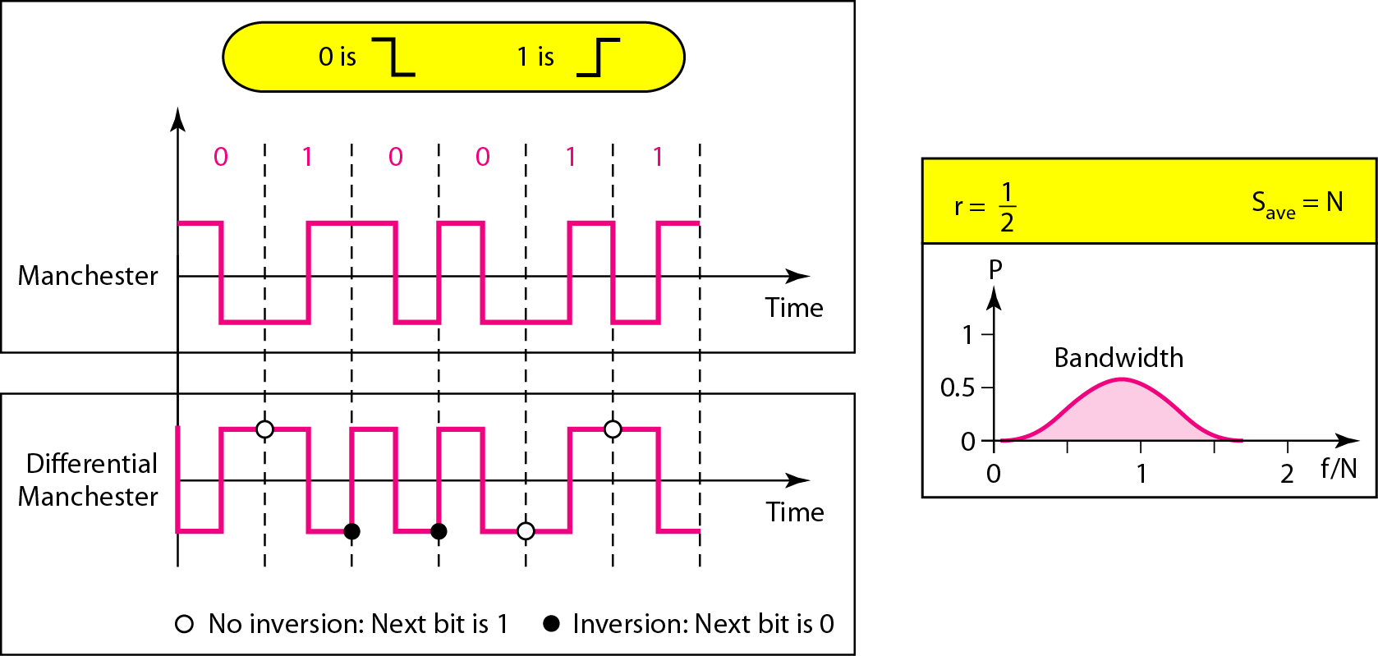
Polar biphase: Manchester and differential Manchester schemes

Slide 34
In Manchester and differential Manchester encoding, the transition at the middle of the bit is used for synchronization.
The minimum bandwidth of Manchester and differential Manchester is 2 times that of NRZ. The is no DC component and no baseline wandering. None of these codes has error detection.

Slide 35
Bipolar
It is a better alternative to NRZ.
Has no DC component or baseline wandering.
Has no self synchronization because long runs of “0”s results in no signal transitions.
No error detection.

Slide 36

Bipolar - AMI and Pseudoternary
Code uses 3 voltage levels: - +, 0, -, to represent the symbols (not transitions to zero as in RZ).
Voltage level for one symbol is at “0” and the other alternates between + & -.
Bipolar Alternate Mark Inversion (AMI) - the “0” symbol is represented by zero voltage and the “1” symbol alternates between +V and -V.
Pseudoternary is the reverse of AMI.

Slide 37
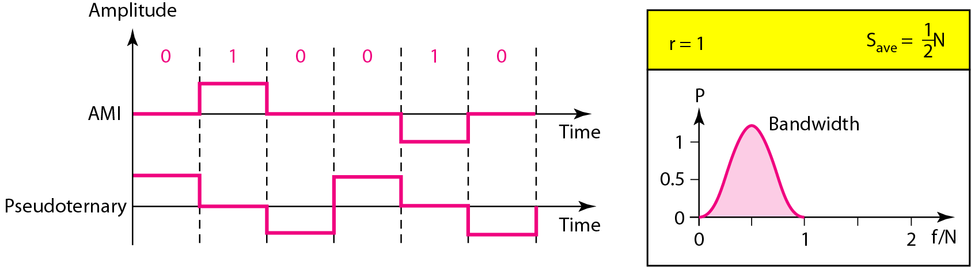
Bipolar schemes: AMI and pseudoternary

Slide 38


Slide 39
Multilevel Schemes
In these schemes we increase the number of data bits per symbol thereby increasing the bit rate.
Since we are dealing with binary data we only have 2 types of data element a 1 or a 0.
We can combine the 2 data elements into a pattern of “m” elements to create “2^{m}” symbols.
If we have L signal levels, we can use “n” signal elements to create L^{n} signal elements.

Slide 40
Code
Now we have 2^{m} symbols and L^{n} signals.
If 2^{m} > L^{n} then we cannot represent the data elements, we don’t have enough signals.
If 2^{m} = L^{n} then we have an exact mapping of one symbol on one signal.
If 2^{m} < L^{n} then we have more signals than symbols and we can choose the signals that are more distinct to represent the symbols and therefore have better noise immunity and error detection as some signals are not valid.
In mBnL schemes, a pattern of m data elements is encoded as a pattern of n signal elements in which 2^{m} ≤ L^{n}.

Slide 41
Representing Multilevel Codes
We use the notation mBnL, where m is the length of the binary pattern, B represents binary data, n represents the length of the signal pattern and L the number of levels.
L = B binary, L = T for 3 ternary, L = Q for 4 quaternary.

Slide 42
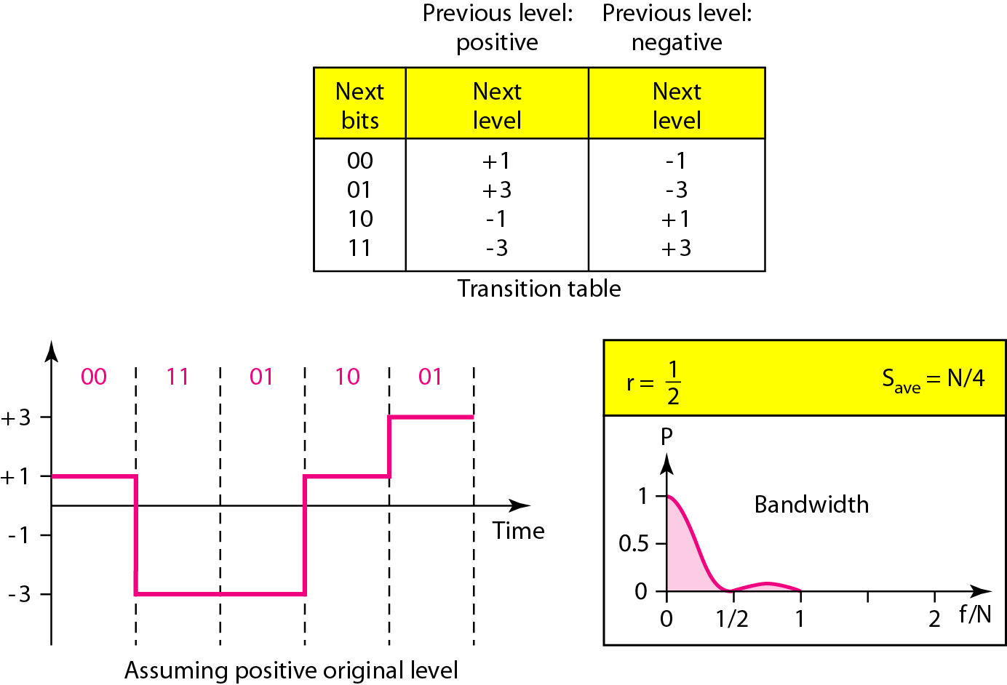
Multilevel: 2B1Q scheme

Slide 43
Redundancy
In the 2B1Q scheme we have no redundancy and we see that a DC component is present.
If we use a code with redundancy we can decide to use only “0” or “+” weighted codes (more +’s than -’s in the signal element) and invert any code that would create a DC component. E.g. ‘+00++-’ -> ‘-00--+’
Receiver will know when it receives a “-” weighted code that it should invert it as it doesn’t represent any valid symbol.

Slide 44
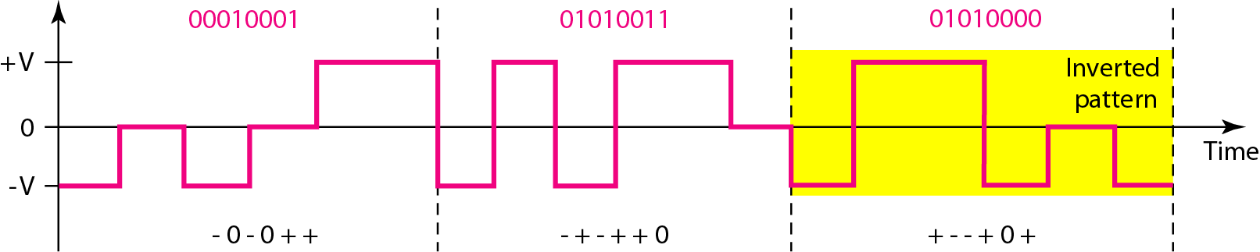
Multilevel: 8B6T scheme

Slide 45
Multilevel using multiple channels
In some cases, we split the signal transmission up and distribute it over several links.
The separate segments are transmitted simultaneously. This reduces the signalling rate per link -> lower bandwidth.
This requires all bits for a code to be stored.
xD: means that we use ‘x’ links
YYYz: We use ‘z’ levels of modulation where YYY represents the type of modulation (e.g. pulse ampl. mod. PAM).
Codes are represented as: xD-YYYz

Slide 46
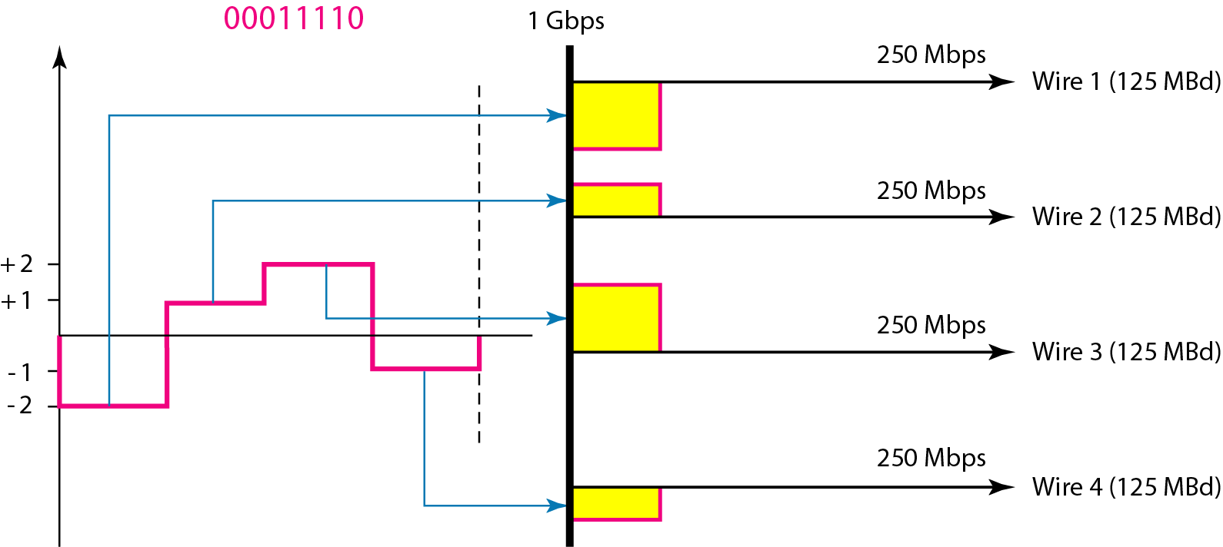
Multilevel: 4D-PAM5 scheme

Slide 47
Multitransition Coding
Because of synchronization requirements we force transitions. This can result in very high bandwidth requirements -> more transitions than bits (e.g. mid bit transition with inversion).
Codes can be created that are differential at the bit level forcing transitions at bit boundaries. This results in a bandwidth requirement that is equivalent to the bit rate.
In some instances, the bandwidth requirement may even be lower, due to repetitive patterns resulting in a periodic signal.

Slide 48
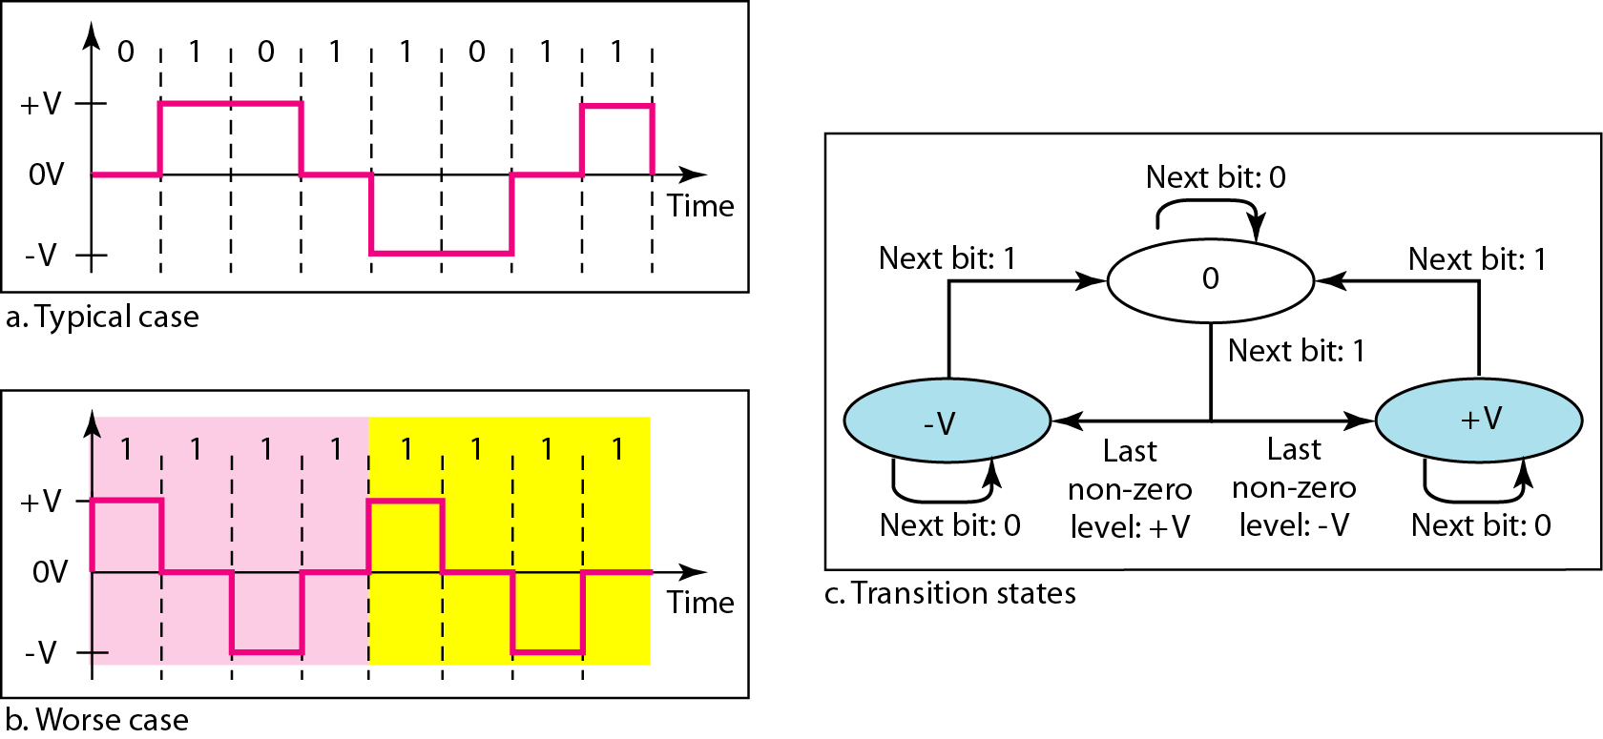
Multitransition: MLT-3 scheme

Slide 49
MLT-3
Signal rate is same as NRZ-I
But because of the resulting bit pattern, we have a periodic signal for worst case bit pattern: 1111
This can be approximated as an analog signal a frequency 1/4 the bit rate!

Slide 50
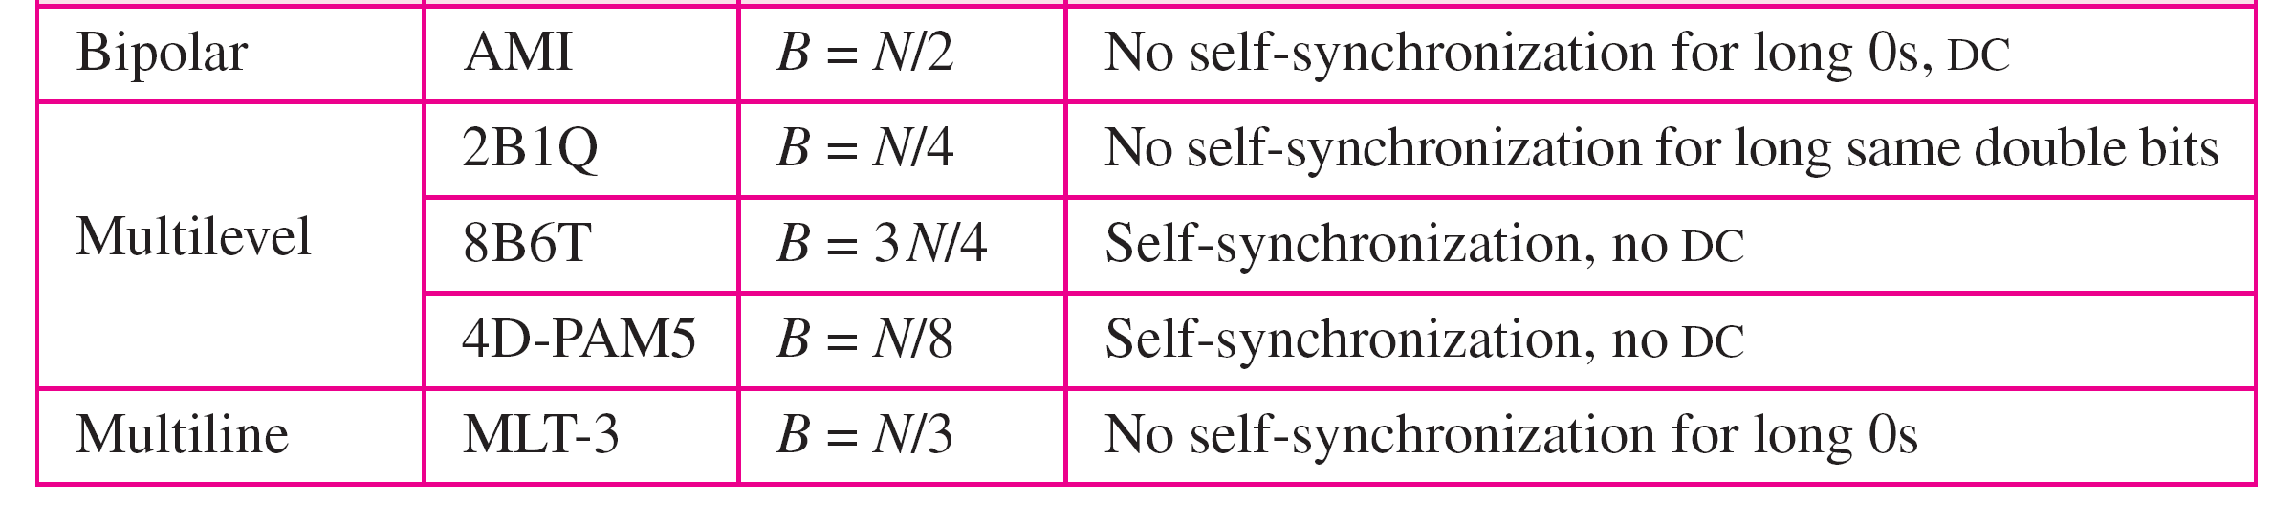
Summary of line coding schemes

Slide 51
Block Coding
For a code to be capable of error detection, we need to add redundancy, i.e., extra bits to the data bits.
Synchronization also requires redundancy - transitions are important in the signal flow and must occur frequently.
Block coding is represented by slash notation, mB/nB. Means, m-bit block is substituted with n-bit block where n > m. Block coding involves three steps:
1. Division
2. Substitution
3. Combination.
After block coding is done, it is line coded for transmission.
It is distinguished from multilevel coding by use of the slash - xB/yB.
The resulting bit stream prevents certain bit combinations that when used with line encoding would result in DC components or poor sync. quality.

Slide 52
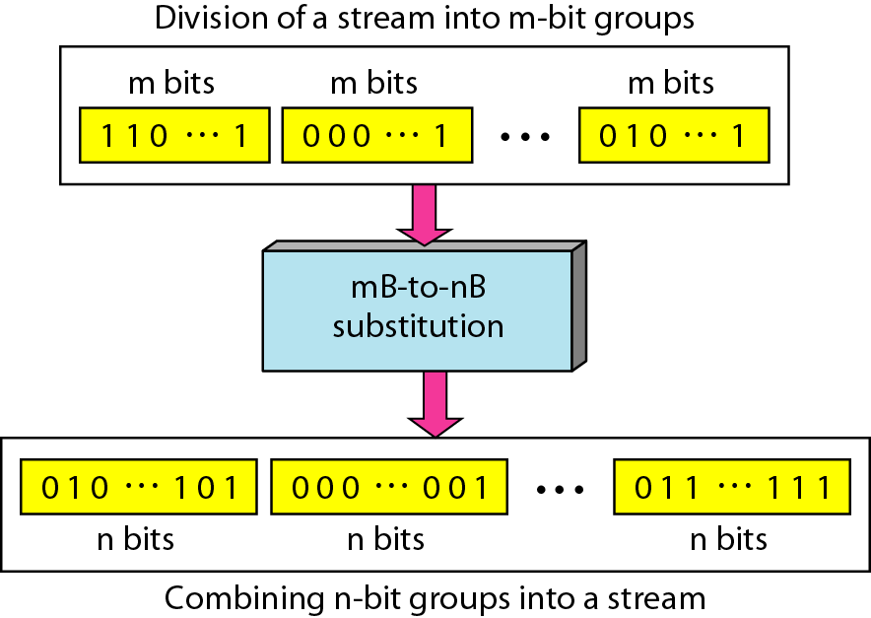
Block coding concept

Slide 53
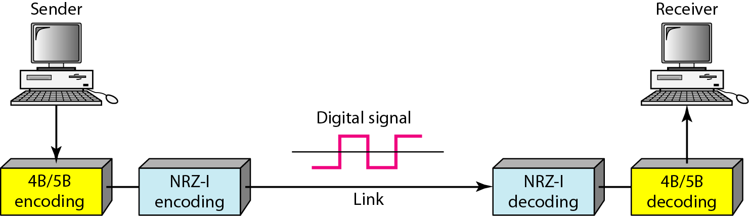
Using block coding 4B/5B with NRZ-I line coding scheme

Slide 54
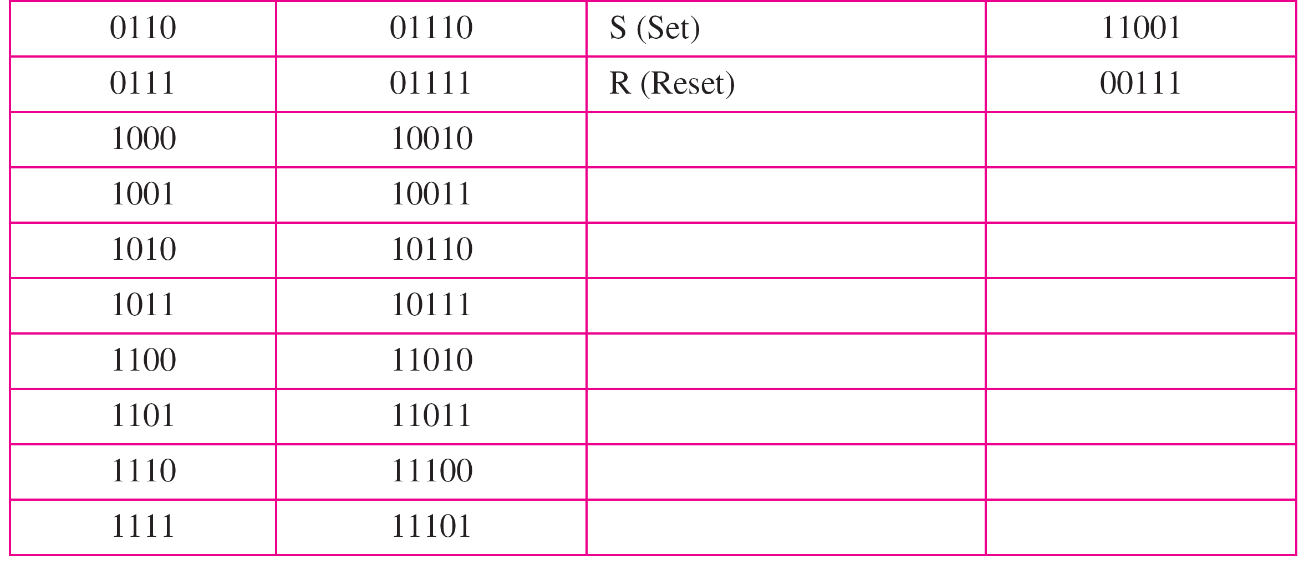
4B/5B mapping codes

Slide 55
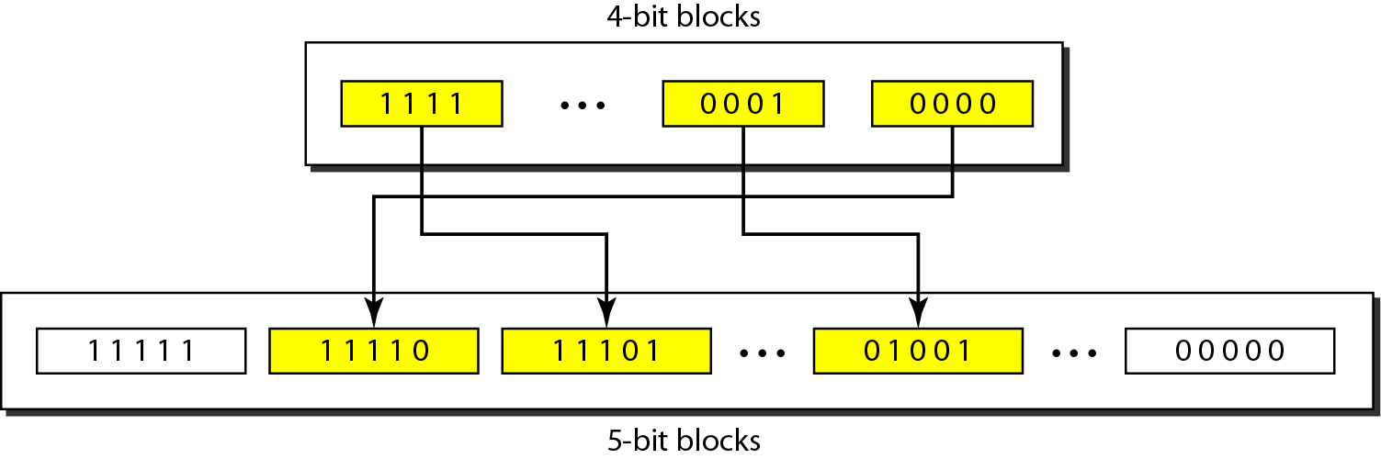
Substitution in 4B/5B block coding

Slide 56
Redundancy
A 4 bit data word can have 16 combinations.
A 5 bit word can have 32 combinations.
We therefore have 32 - 16 = 16 extra words.
Some of the extra words are used for control/signalling purposes.

Slide 57
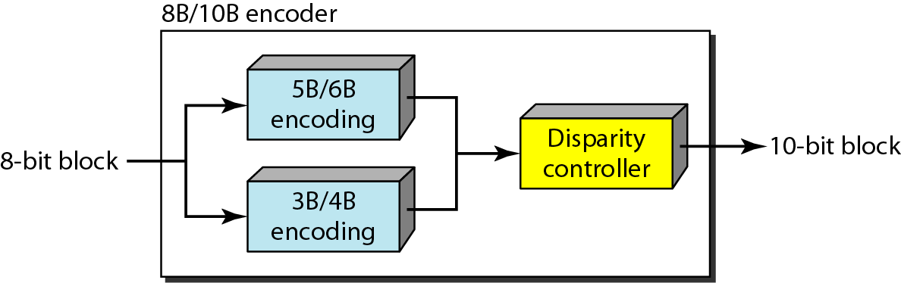
8B/10B block encoding

Slide 58
More bits - better error detection
The 8B10B block code adds more redundant bits and can thereby choose code words that would prevent a long run of a voltage level that would cause DC components.

Slide 59
Scrambling
The best code is one that does not increase the bandwidth for synchronization and has no DC components.
Scrambling is a technique used to create a sequence of bits that has the required characteristics for transmission - self clocking, no low frequencies, no wide bandwidth.
It is implemented at the same time as encoding, the bit stream is created on the fly.
It replaces ‘unfriendly’ runs of bits with a violation code that is easy to recognize and removes the unfriendly characteristics.

Slide 60
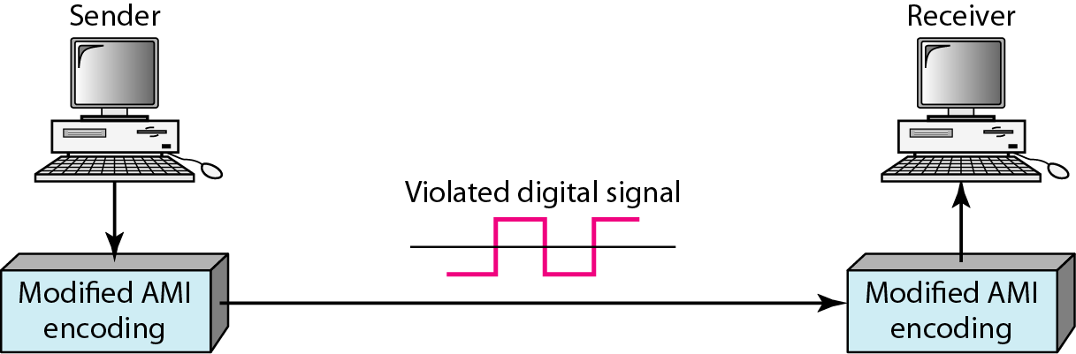
AMI used with scrambling

Slide 61
For example: B8ZS substitutes eight consecutive zeros with 000VB0VB.
The V stands for violation, it violates the line encoding rule
B stands for bipolar, it implements the bipolar line encoding rule

Slide 62
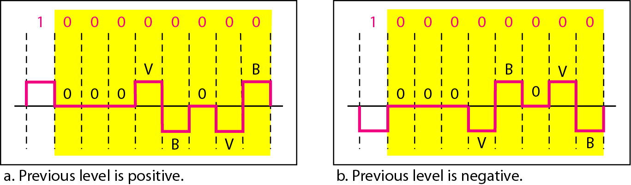
Two cases of B8ZS scrambling technique

Slide 63
HDB3 substitutes four consecutive zeros with 000V or B00V depending on the number of nonzero pulses after the last substitution.
If # of non zero pulses is even the substitution is B00V to make total # of non zero pulse even.
If # of non zero pulses is odd the substitution is 000V to make total # of non zero pulses even.

Slide 64
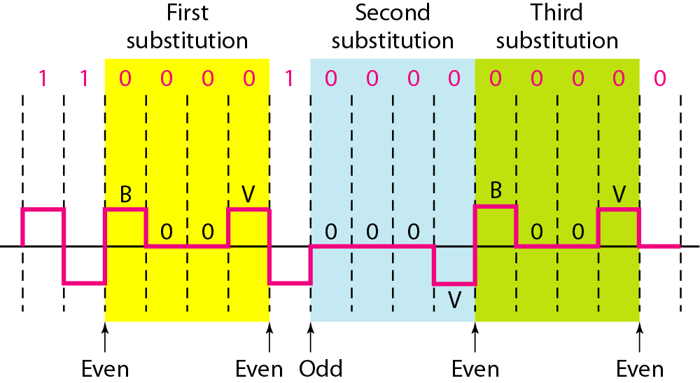
Different situations in HDB3 scrambling technique

